Slide 1

Lecture – 9/29/2016
CSCI 36300 – Software Design

Slide 2

Career Connection STEM Career Fair

Slide 3
Assignment #2 Questions?

Slide 4
Quiz #6

Slide 5
Advanced C++ Topics

Slide 6
Functors
What are functors?
They are an object of a class type that implements the function-call operator, allowing the object to be used within expressions using the same syntax as a function call.
Functors are stateful objects, being able to contain their own data values and allowing the programmer to emulate closures.

Slide 7
Functors
How do we use functors in C++?
We must overload the () operator – aka the function call operator.
This is one of the most flexible operator overloads possible.
Wait…but what is a closure?
Let’s consult our good friend Theory of Programming Languages…
Similar to Lambda Functions
New to C++11
Functional Programming Language concept

Slide 8
Closures
A closure is a subprogram and the referencing environment where it was defined.
The referencing environment is needed if the subprogram can be called from any arbitrary place in the program.
Closures are only needed if a subprogram can access variables in nesting scopes and it can be called from anywhere.
To support closures, an implementation may need to provide unlimited extent to some variables (because a subprogram may access a nonlocal variable that is normally no longer alive).

Slide 9
Functors
#include <iostream>
class myFunctorClass
{
public:
myFunctorClass (int x) : _x( x ) {}
int operator() (int y) { return _x + y; }
private:
int _x;
};
int main()
{
myFunctorClass addFive( 5 );
std::cout << addFive( 6 );
return 0;
}

Slide 10
Functors Example

Slide 11
Comparisons
Functors vs. Function Pointers
If you have a function that takes a function pointer, you cannot pass in a functor as though it were a function pointer.
They are incompatible types – function pointers need the compile time definition – functors behavior is achieved at runtime.
A function that expects a functor, cannot be passed a function pointer.
See above reasoning…

Slide 12
Comparisons
Functors vs. Virtual Methods
Closely related but some minor differences.
Virtual functions do not give you the ability to write a templated function that can also accept function pointers.
Static vs. Dynamic Polymorphism
Hint, Hint – Virtual Template Functions ☹
Virtual Method provides simpler syntax and often is preferred for small projects.
Fit the very definition of OO design & programming.

Slide 13
Comparisons
Usage (When/Why/How)?
Function Pointers
Functors
Templates
Helps to aid clarity to your code – but must take care in specifying and understanding each method.
Dynamic vs. Static

Slide 14
OO Design & Programming

Slide 15
Rotten Design

Slide 16
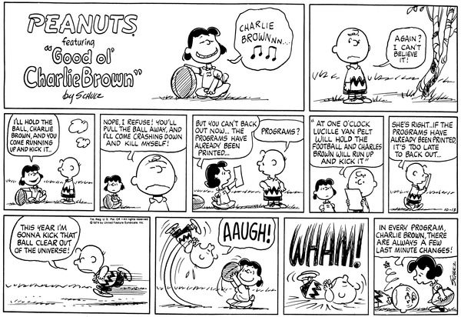
Principles of Rotten Design
We start off with such grand aspirations and think THIS will be the time we do everything right….
…and then it all goes wrong.

Slide 17
Principles of Rotten Design
Software is really a living breathing thing.
It evolves over time, we cut corners to meet deadlines or put in that “short term” hack to make a work around.
Is it really saving us time in the end?
What are the consequences of this approach?
We call this degradation rotten design.
What exactly is rotten design – how can we spot/avoid it?

Slide 18
Rotten Design
A slow deterioration of software performance over time.
Environmental Impacts
How do we prepare for the future – where is our crystal ball?
Example:
Duck Hunt game – modern TV’s refresh

